Slide 1
HSOY52S1-2020US KATO NA: Evaluation of SYN550023 efficacy on ACCase resistant grasses (LOLMU and SETVI) EPOST
Holloway, James
Vaz Da Silva, Joao Renato, Eric Palmer
2020 Crop Protection Field Development
Last Updated: AUG-26-2020

Slide 2
Acknowledgements and Test Locations:
Trial | State | Cooperator/ Syngenta Rep | IH/ CRO/ COI | Target | Data was available for the summary presentation (Y/N) | Data was used to answer the protocol objective(s) (Y/N)
USNN0H0362020 | ND | Miller, Brett | IH | SETVI – (ACCASE-R – FOP only) | Y | Y
USNP0H0052020 | OK | Lindenmayer, Brad | IH | LOLMU (ACCASE-R) | Y | Y
USSB0H0212020 | MS | Jackson, Ryan | IH | LOLMU (GLY-R) (ACCASE-R) | Y | Y
USSG0H0262020 | TN | Holloway, James | IH | LOLMU (GLY-R) (ACCASE-R) | Y | Y

Slide 3
Objectives:
How does SYN550023 perform against ACCase resistant grasses?
What is the optimum SYN550023 rate to control ACCase resistant populations in field conditions?
How does SYN550023 compare to clethodim on ACCase resistant grasses?

Slide 4
Treatment List
TRT | Product AI Rate Unit | Application Code*
1 | Untreated
2 | SYN'023 200 EC 25 g + Agridex 1% + AMS 2.5% | A
3 | SYN'023 200 EC 50 g + Agridex 1% + AMS 2.5% | A
4 | SYN'023 200 EC 100 g + Agridex 1% + AMS 2.5% | A
5 | SYN'023 200 EC 200 g + Agridex 1% + AMS 2.5% | A
6 | SelectMax 100 g + Agridex 1% + AMS 2.5% | A
7 | Fusilade DX 280 g + Agridex 1% + AMS 2.5% | A
8 | Roundup Powermax 4.5 1120 g + AMS 2.5% | A
Notes:
Auto-populated

Slide 5
Italian Ryegrass Control (7 DAA)
All treatments had AMS 2.5% and COC 1%

Slide 6
Italian Ryegrass Control (14 DAA)
All treatments had AMS 2.5% and COC 1%

Slide 7
Italian Ryegrass Control (28 DAA)
All treatments had AMS 2.5% and COC 1%
Note: MS-2 site was over sprayed by the grower with Gramoxone at 26 DAA

Slide 8
Italian Ryegrass Control (42 DAA)
All treatments had AMS 2.5% and COC 1%
Note: MS-1 site was mowed by the grower at 36 DAA

Slide 9
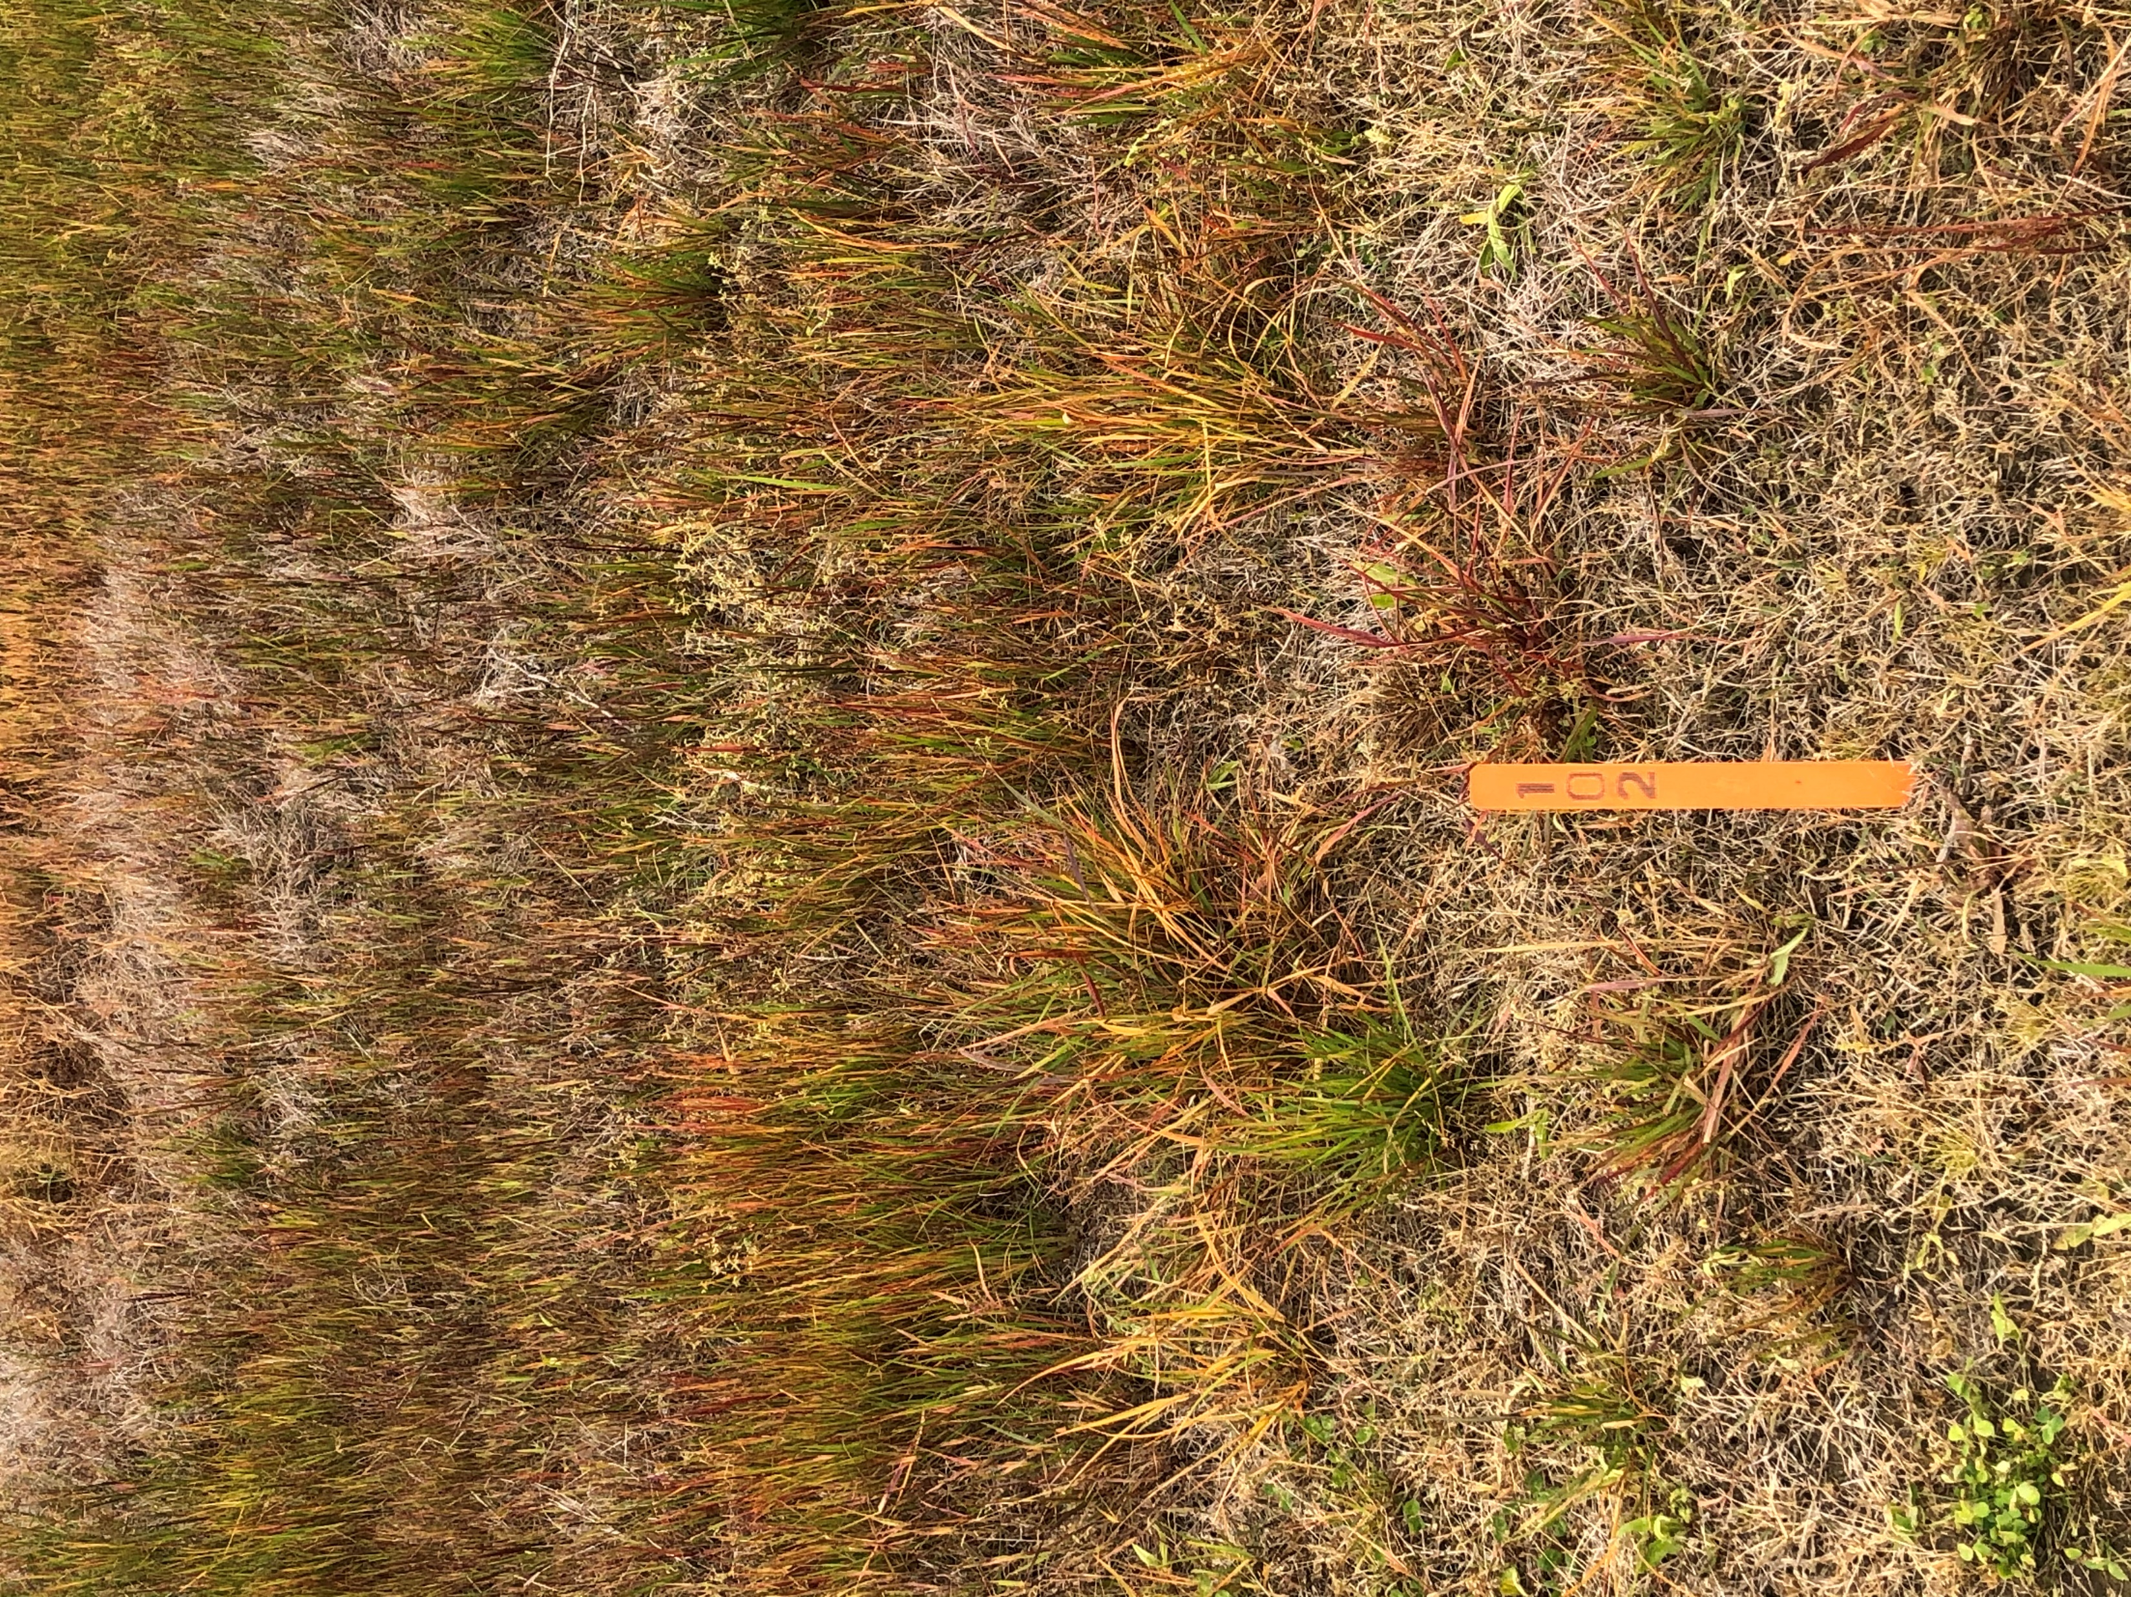
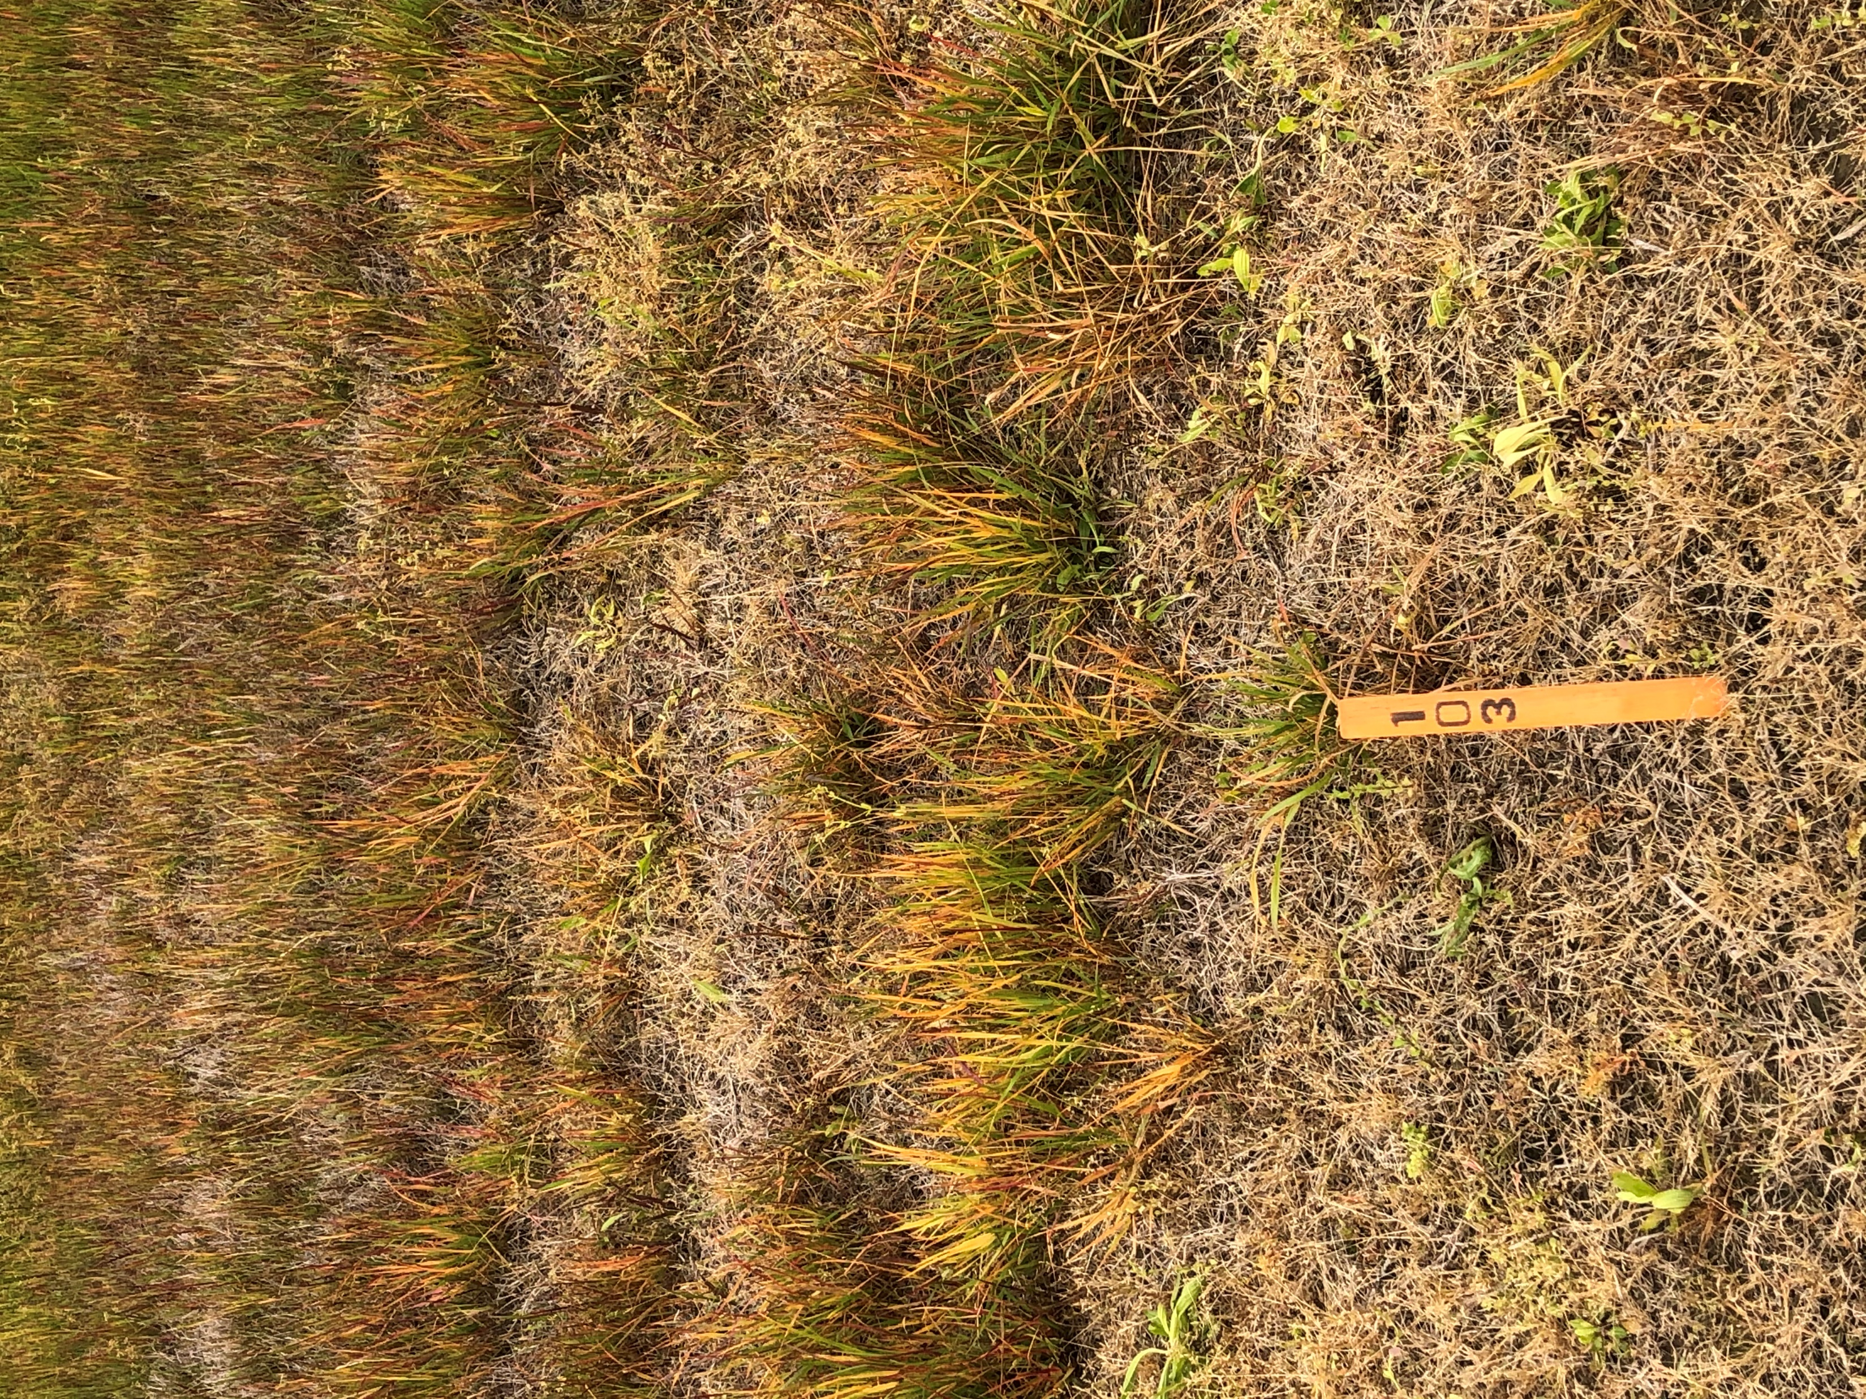
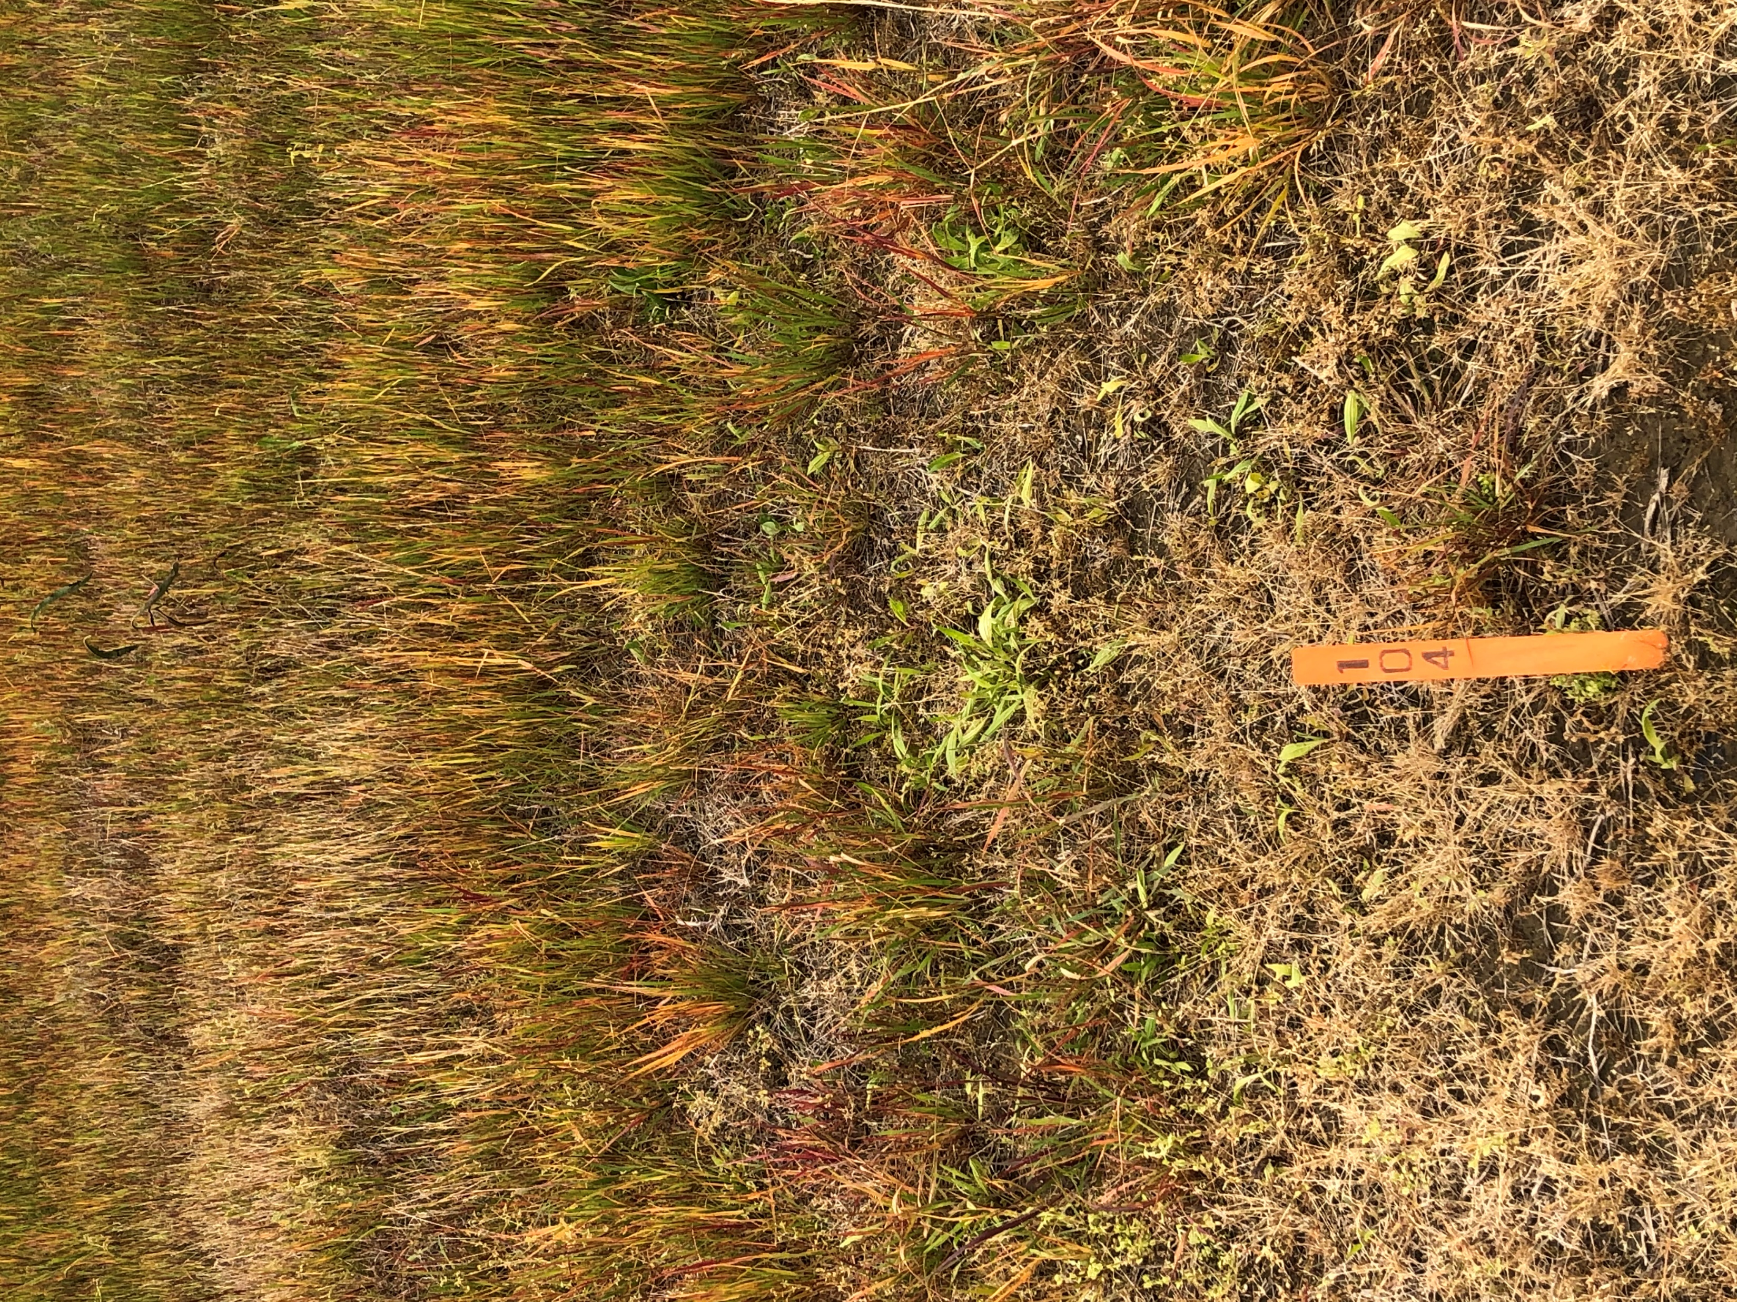
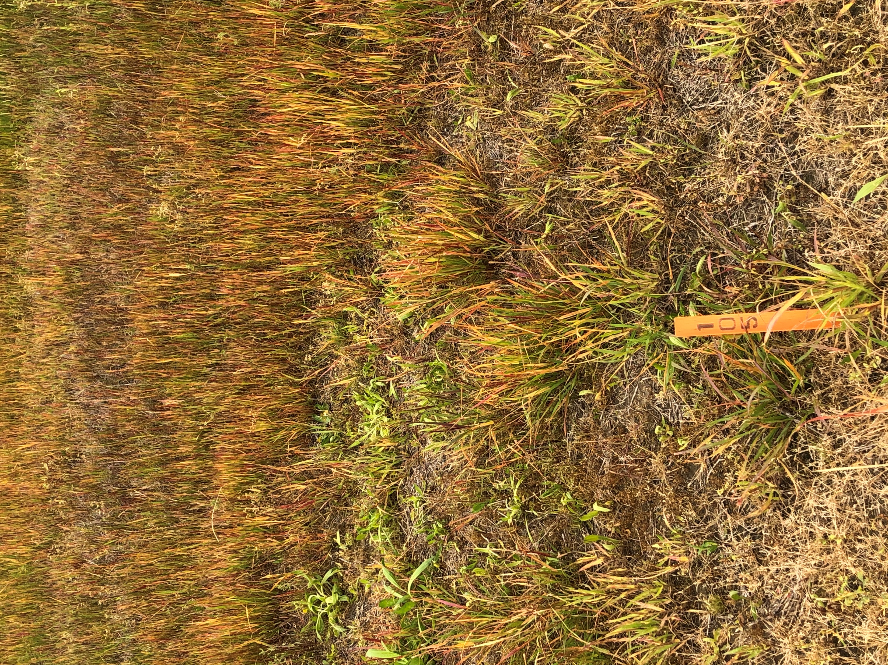
SYN550023 25, 50, 100 and 200 g 14 DAT - MS
25 g
50 g
100 g
200 g

Slide 10
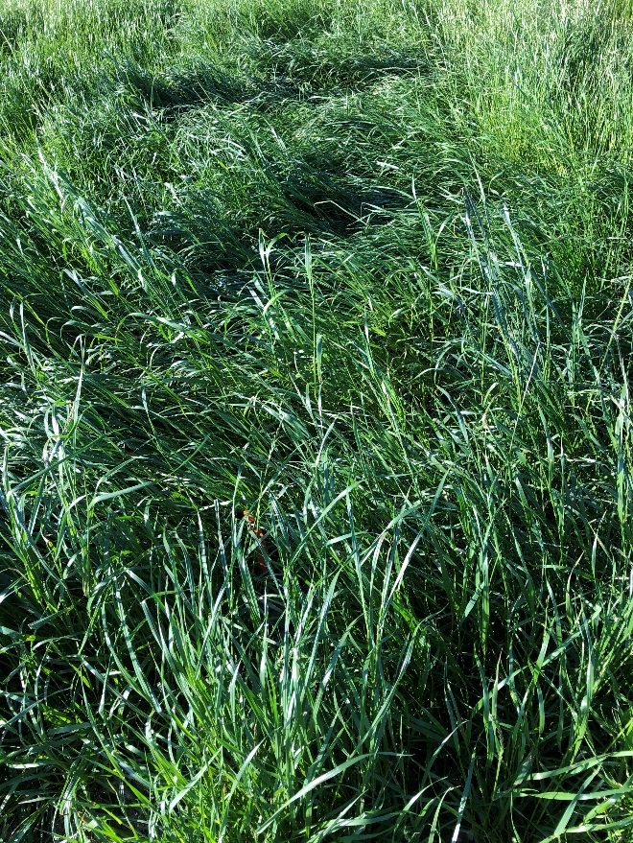

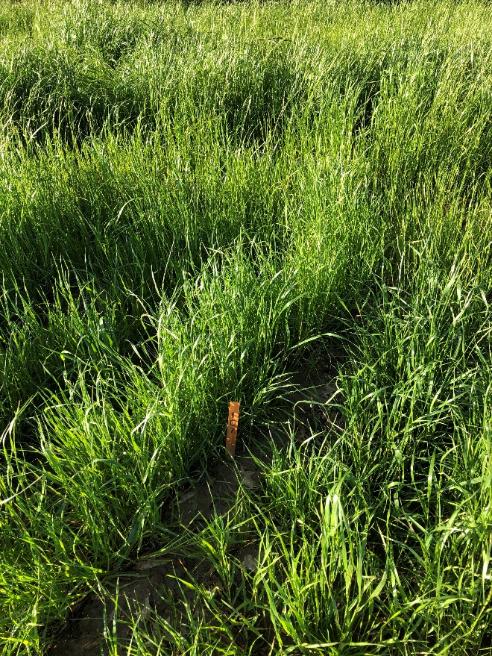
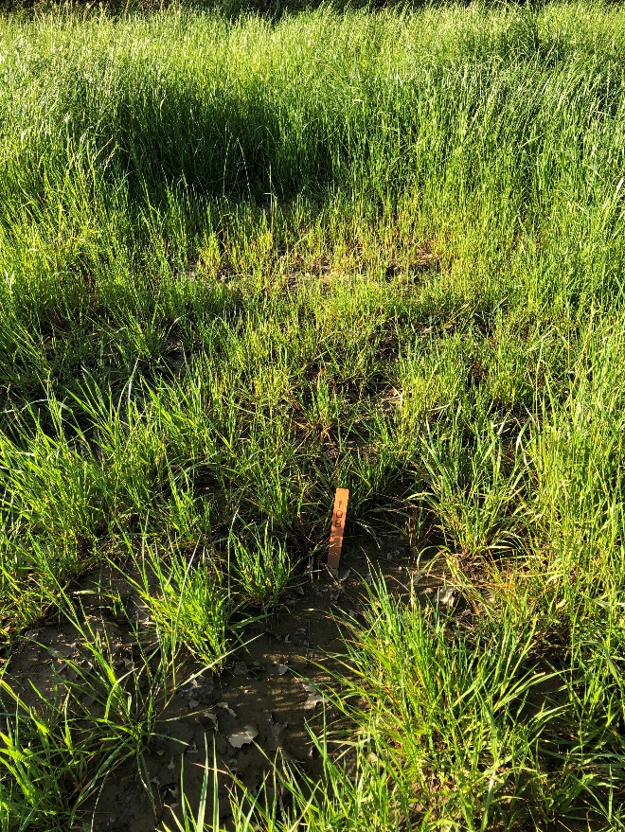
Did the site have enough target pest pressure to answer protocol objectives, and did how did standards perform?
Untreated Check
Select Max 0.97 EC
100 ga/ha
Fusilade DX 2 EC
280 ga/ha
Roundup Powermax 4.5 SL
1120 gae/ha
Pictures taken at 28 DAA

Slide 11
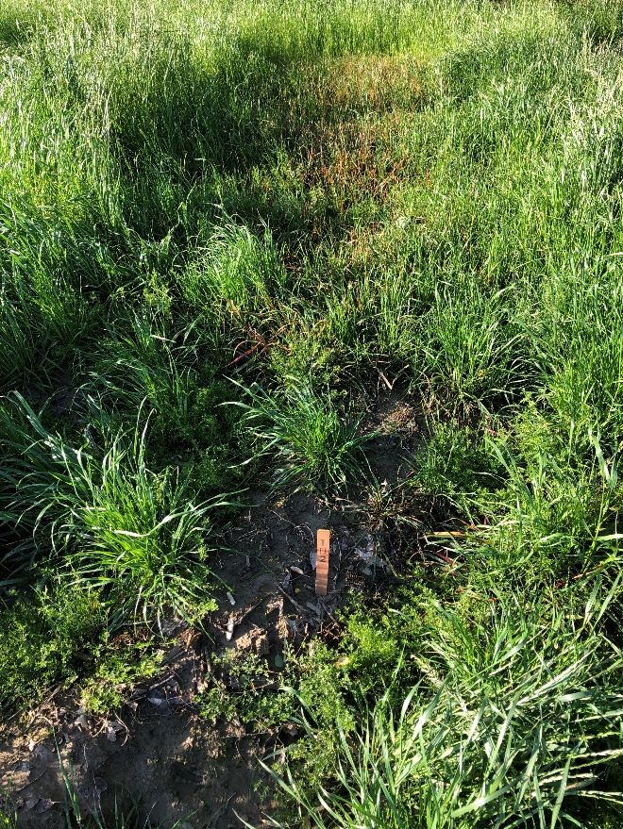

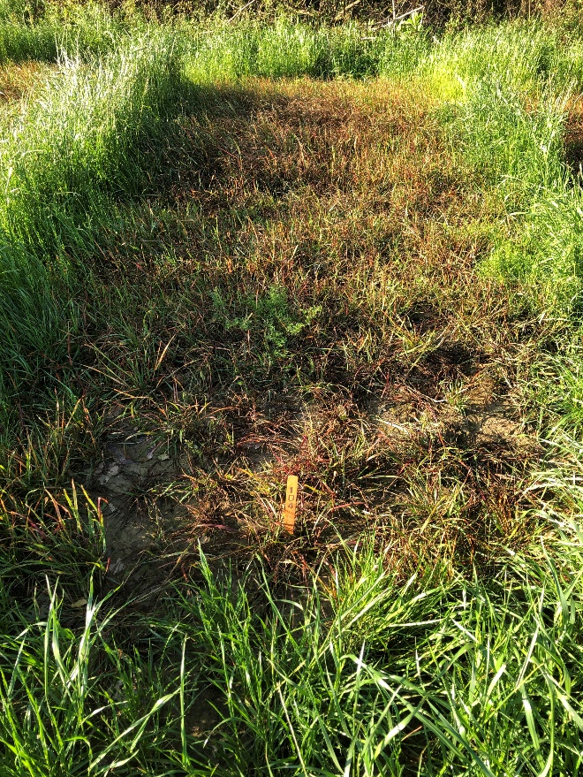
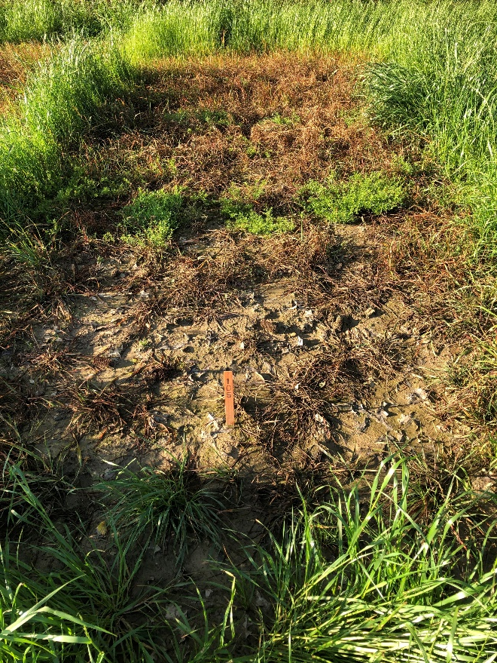
How does SYN550023 perform against ACCase resistant grasses? What is the optimum SYN550023 rate to control ACCase resistant populations in field conditions?
SYN550023 200 EC
25 ga/ha
SYN550023 200 EC
50 ga/ha
SYN550023 200 EC
100 ga/ha
SYN550023 200 EC
200 ga/ha
Pictures taken at 28 DAA

Slide 12
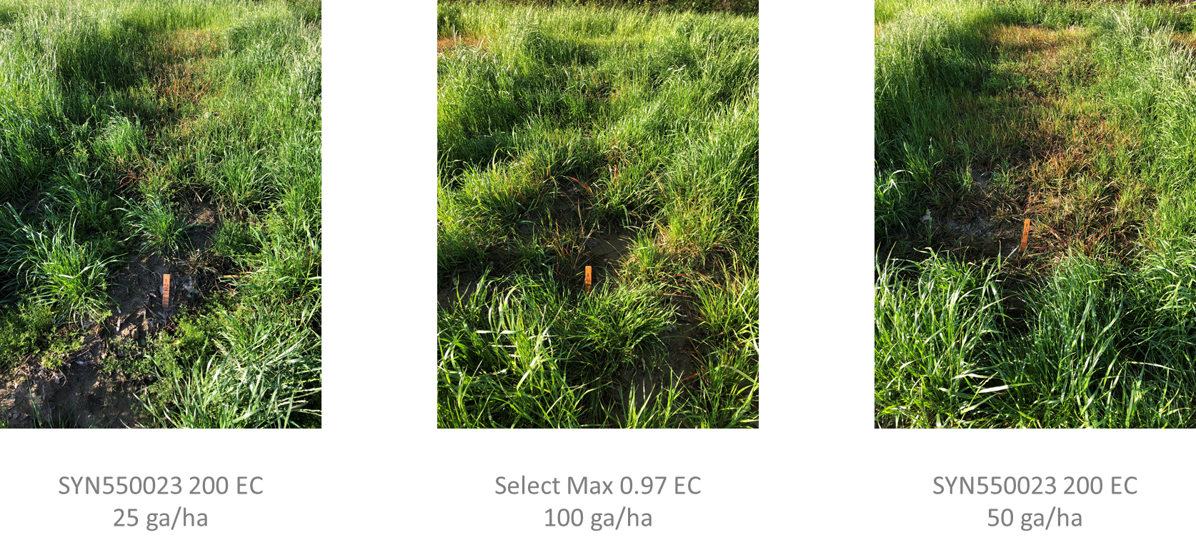
How does SYN550023 compare to clethodim on ACCase resistant grasses?
Pictures taken at 28 DAA

Slide 13
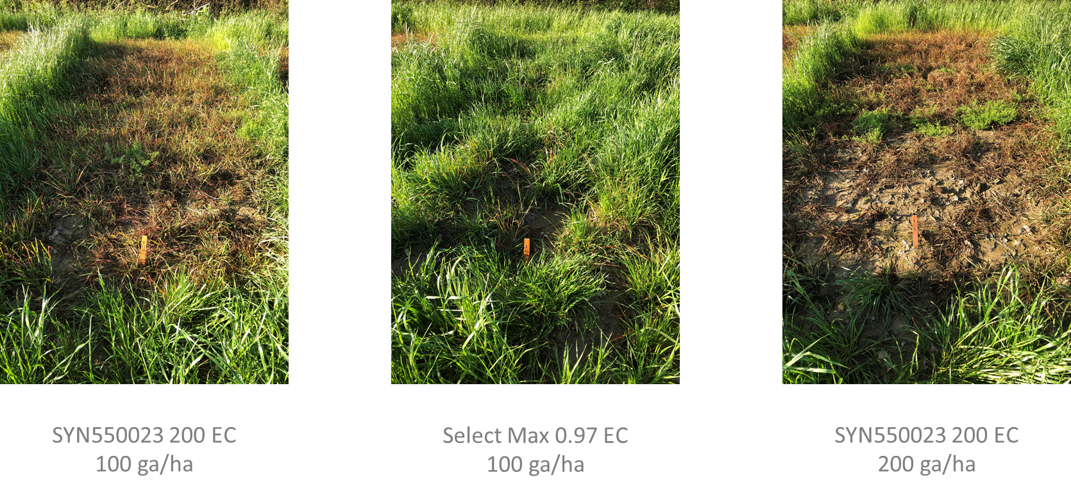
How does SYN550023 compare to clethodim on ACCase resistant grasses? (continued)
Pictures taken at 28 DAA

Slide 14
Green Foxtail Control (7 DAA)
All treatments had AMS 2.5% and COC 1%
Note: MS-1 site was mowed by the grower at 36 DAA

Slide 15
Green Foxtail Control (14 DAA)
All treatments had AMS 2.5% and COC 1%
Note: MS-1 site was mowed by the grower at 36 DAA

Slide 16
Green Foxtail Control (28 DAA)
All treatments had AMS 2.5% and COC 1%
Note: MS-1 site was mowed by the grower at 36 DAA

Slide 17
Volunteer wheat Control (7 DAA)
All treatments had AMS 2.5% and COC 1%
Note: MS-1 site was mowed by the grower at 36 DAA

Slide 18
Volunteer wheat Control (14 DAA)
All treatments had AMS 2.5% and COC 1%
Note: MS-1 site was mowed by the grower at 36 DAA

Slide 19
Volunteer wheat Control (28 DAA)
All treatments had AMS 2.5% and COC 1%
Note: MS-1 site was mowed by the grower at 36 DAA

Slide 20
Volunteer wheat Control (42 DAA)
All treatments had AMS 2.5% and COC 1%
Note: MS-1 site was mowed by the grower at 36 DAA

Slide 21
Results: LOLMU - 7 DAA

Slide 22
Results: LOLMU – 14 DAA
Note - MS-2 was lost following the 14-day rating

Slide 23
Results: LOLMU – 28 DAA
Note: MS-2 site was over sprayed by the grower with Gramoxone at 26 DAA

Slide 24
Results: LOLMU – 42 DAA
Note: MS-1 site was mowed by the grower at 36 DAA

Slide 25
Results: SETVI – 7 DAA

Slide 26
Results: SETVI – 14 DAA

Slide 27
Results: SETVI – 28 DAA

Slide 28
Summary: Objectives answered & additional conclusions/observations
How does SYN550023 perform against ACCase resistant grasses?
LOLMU – SYN5650023, 200 EC, 200 g rate to provided 88% on average at 28 DAA (MS-1 and OK locations). Compared to 40% with Select Max at the same timing. By 42 DAA, OK, control was 90% with 200 g of SYN’023 and 53% with Select Max
*SETVI – SYN550023 200 EC, 200 g rate provided similar control to Select Max at 100 g, 87 and 88% control, respectively, 28 DAA.
What is the optimum SYN550023 rate to control ACCase resistant populations in field conditions?
LOLMU – minimum of 200 g
SETVI – minimum of 200 g

Slide 29
Summary: Objectives answered & additional conclusions/observations
How does SYN550023 compare to clethodim on ACCase resistant grasses?
LOLMU – 28 DAA, 25 g of SYN’023 provided similar control, (47%), to Select Max, (40%). By 42, 50 g of SYN’023 provided similar control, (50%), to Select Max, (53%). However, 200 g of SYN’023 was needed to provide commercially acceptable control of this weed, (90%).
*SETVI – Clethodim at 100 g provided 88% control while 100 g of SYN550023 provided 50% control and the 200 g rate provided 87% control
Volunteer winter wheat control
OK – Volunteer winter wheat control was noted with SYN’023 200 g, 92%, Select Max 100 g, 75%, and Fusilade DX, 280g, 98%, 42 DAA
* SETVI - 2-3 years ago Vero characterized it as Accase-R - pinoxaden, clodinafop, fenoxaprop

Slide 30
Recommendations:
Continue rate range testing from 100 - 200 g rate or higher for control of ACCase grasses including LOLMU and SETVI
Continue to add a fop and a dim into each trial where ACCase suspected populations occur
Re-test in 2021 on known ACCase/Gly resistant populations and consider tank mix partners such as GLY or GLU

